Slide 1

Introduction to C
Sub : Introduction To Programming
Class: BCA – A
Members
By : Group D
S No. | NAME | ROLL NO
1. | TANISHA CHAKRABORTY | 16
2. | RITIKA BERA | 17
3. | AYAN DAS | 18
4. | SHUBHADIP MONDAL | 19
5. | ANUSHKA SAHA | 20

Slide 2
Welcome To
Our
Presentation

Slide 3
What is C ?
C is a high-level programming language that was invented by Dennis Ritchie at 1972 at Bell Labs. It is widely known for its efficiency and control over system resources, making it ideal for systems programming, including developing operating systems, embedded systems, and other software where performance is critical.
C is also known as the mother of all languages.
It serves as the foundation for many higher-level languages, including C#, Java, Python, and more. C's efficiency and versatility make it suitable for a wide range of applications.

Slide 4
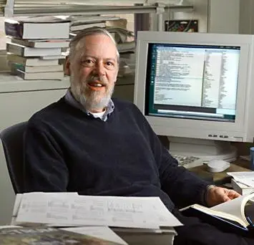
Creator Of C
Dennis Ritchie
Dennis Ritchie was an American computer scientist also known for his significant contributions to the development of computer programming languages and operating systems. He was born on September 9, 1941, and passed away on October 12, 2011.
He is widely regarded as one of the most influential figures in modern computing.
Dennis Ritchie is the creator of the C programming language that was developed at Bell Labs in the 1972. C became one of the most widely used programming languages in history due to its versatility, efficiency, and portability across different platforms.

Slide 5

Development in C
C has evolved from a system programming language to a foundation of software development, shaping how modern programming languages are designed and used today.
Despite the rise of newer languages, C’s portability, efficiency, and flexibility continue to make it a critical tool for software developers. The enduring relevance of C in systems programming, compilers, and performance-critical applications showcases its timeless design.
C remains one of the most popular languages for writing operating systems, embedded systems, device drivers, and real-time applications due to its performance and low-level control over memory.

Slide 6
Advantages & Disadvantages Of C
Advantages
Disadvantages
Lack of Memory Management
Lack of built in error checking
Absence of Object-oriented programming
Limited Standard Library
Lack of Standardardized String Handling
Vulnerable to Undefined Behaviour
Efficiency
Structured Programming
Rich Library
Dynamic Memory Allocation
Speed
Extensibility

Slide 7
Applications of C
Operating Systems
Embedded Systems
Compilers
& Interpreters
Databases
Game Development
: such as Linux, Unix , windows
: such as automobiles, smartphones
: programming language to machine language
: handles massive amount of data
: performance & high hand graphics

Slide 8
Header Files in C
stdio.h
(Standard Input Output ) is basically a header file in C that provides functions for performing input & output operations.
conio.h
(Console Input Output ) is non-standard library header file in C that provides
Console input output functions .
math.h
It is basically a header file in C that provides mathematical functions for performing various mathematical operations

Slide 9
Variables in C
Declaration: Introduces a variable and its type.
Initialization: Assigns a value to the variable.
Data Types: Defines the type of data a variable can hold.
Scope: Determines where the variable can be accessed.
Storage Classes: Defines the lifetime and visibility of variables.
Constants: Variables whose values cannot be changed

Slide 10
Commands in C
Control Flow Statements :
if, else, else if, switch, case, default, while, do, for, break, continue, goto
Declaration and Definition:
typedef, struct, union, enum
Input/Output Statements:
printf, scanf
Function Statements:
return
Variable and Memory Statements:
sizeof, malloc, free
Other Constructs:
const, volatile, inline

Slide 11
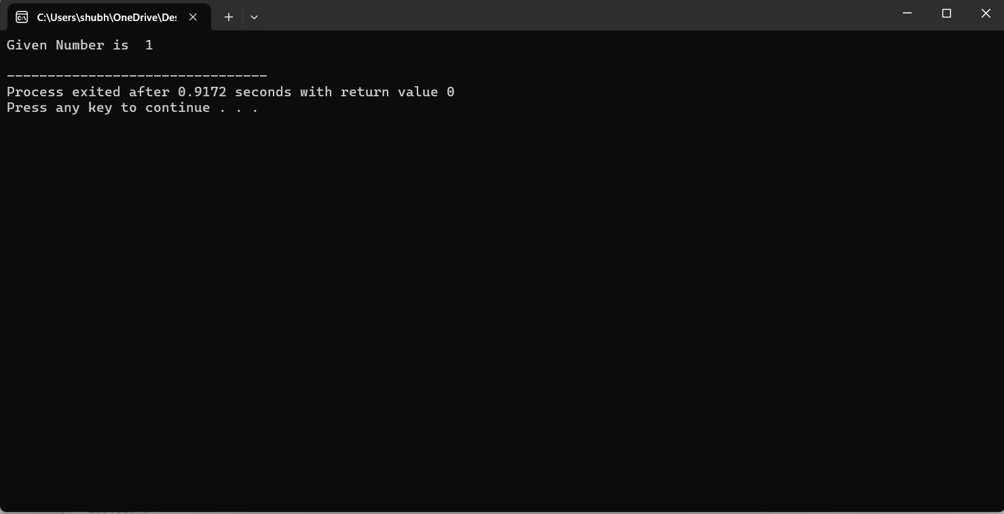
Syntax in C
Output
#include<stdio.h>
#include<conio.h>
void main ( ) or int main ( )
{
int a = 1;
printf("Given Number is %d\n", a);
getch ( ); // reads a single character;
return 0;
}
Header files
Main Function
Variables
Comments
returns the control
To print the output
Format specifier

Slide 12
Datatypes in C
Primitive Data Types:
The most basic data types in C are known as primitive data types. These include:
int: Used to store integers without decimal points. It typically requires 4 bytes of memory and can range from -2,147,483,648 to 2,147,483,647.
char: Stores a single character and requires 1 byte of memory. It can range from -128 to 127 or 0 to 255.
float: Holds floating-point numbers or decimals with single precision. It occupies 4 bytes of memory and has a range of 1.2E-38 to 3.4E+38.
double: Similar to float but with double precision, meaning it can store decimal numbers with more digits. It takes up 8 bytes of memory and ranges from 1.7E-308 to 1.7E+308.

Slide 13
Keywords in C
There are total 32 keywords in C language:
auto , break , case, char, const, continue, default, do, double, else, enum, extern, float, for, goto, if, int, long, register, return, short, signed, sizeof, static, struct, switch, typedef, union, unsigned, void, volatile , while.
* Keywords are reserved words with special meanings in C.
* They help to define the structure, behavior and types of data in C.
* Do not use keywords as identifiers (e.g. variable name or function names ) in code.

Slide 14
Thank You

